Slide 1

Machine Learning and Data Analysis Project
Bisio Giacomo 4854973
Pastore Luca 4858713

Slide 2
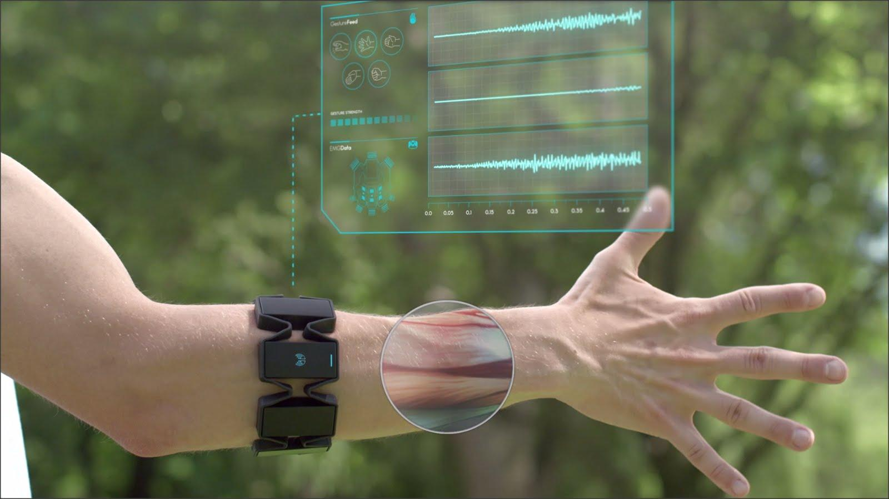
Classify gestures by reading muscle activity
Recording of human hand muscle activity producing four different hand gestures
Data collected using EMG (Electromyography) sensors
Armband with 8 sensors placed on skin surface, each measures electrical activity produced by muscles beneath

Slide 3
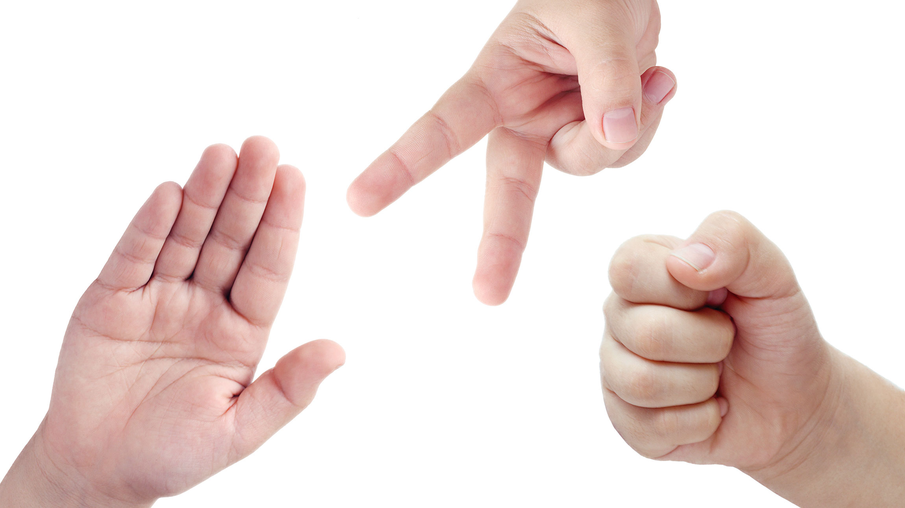
Goal of the project
Create a model that is able to classify different gestures starting from data obtained by the sensors
4 possible gestures:
0 – Rock
1 – Scissors
2 – Paper
3 – Okay

Slide 4
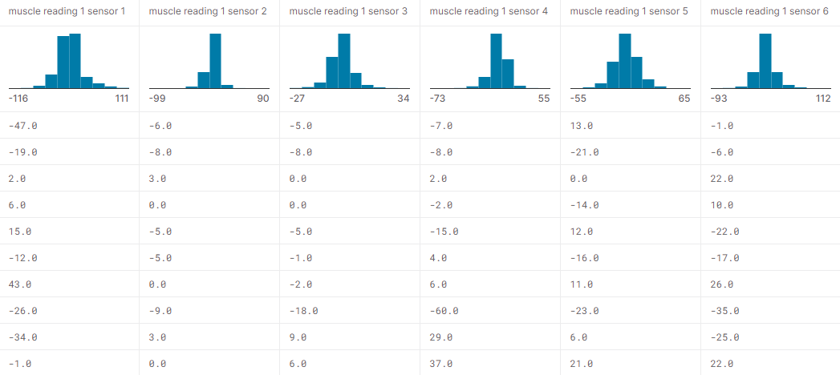
Dataset
4 csv files, one for each gesture class
Each dataset line has 8 consecutive readings of all 8 sensors (64 columns)
Data recorded at 200 Hz, each gesture recorded 6 times for 20 seconds.
Total: ~ 3000 rows for each file
https://www.kaggle.com/datasets/kyr7plus/emg-4

Slide 5
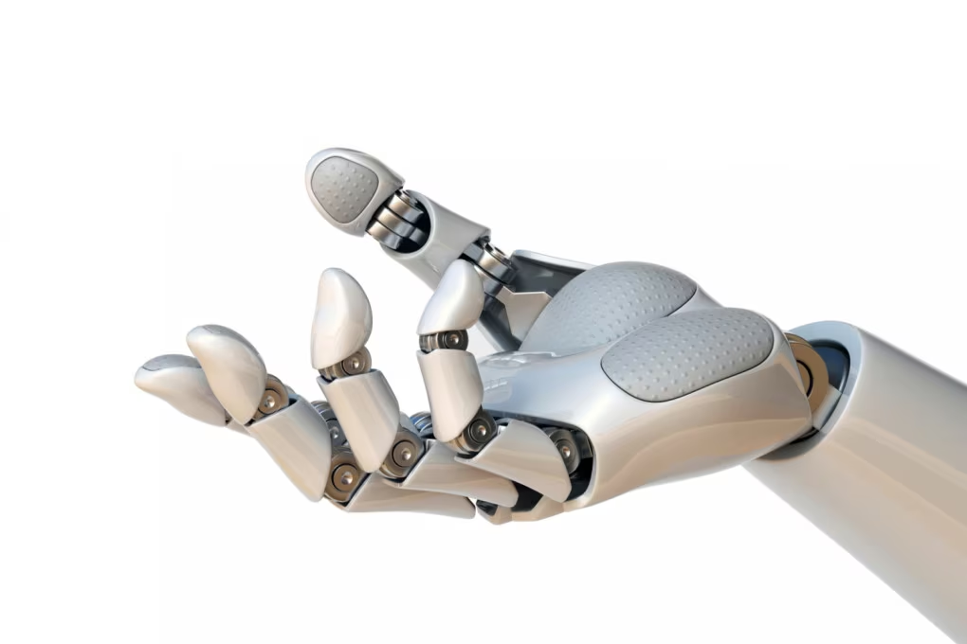
Multiclass Classification problem
3 algorithms:
KRR (one-versus-rest)
SVC (one-versus-rest)
Random Forest

Slide 6
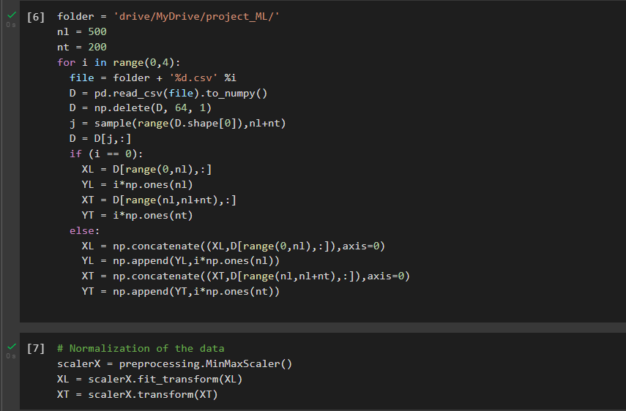
Initialization
4 csv files
500 samples for training for each class
200 samples for testing for each class
Normalization of data

Slide 7
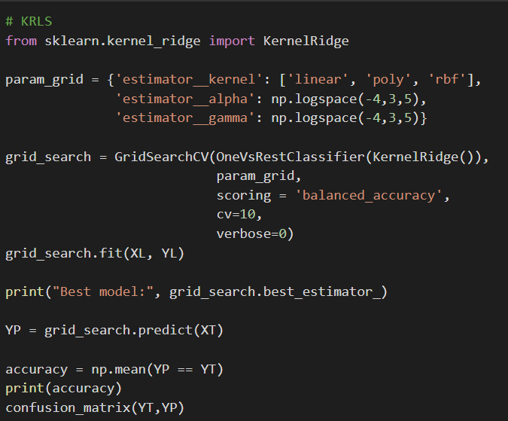
KRR
Kernel Ridge Regression
One-versus-rest
Grid Search
Kernel : Linear, Polynomial, Rbf
Alpha (regularizer)
Gamma

Slide 8
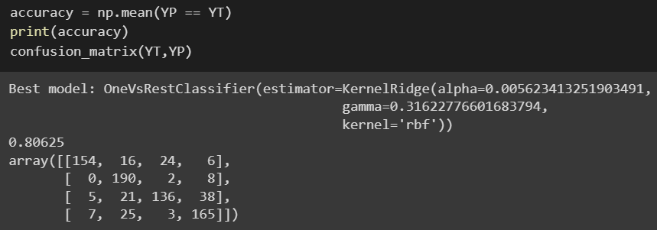
KRR results
Optimal parameters for alpha, gamma
Rbf kernel
Accuracy ~ 81%
Confusion matrix

Slide 9
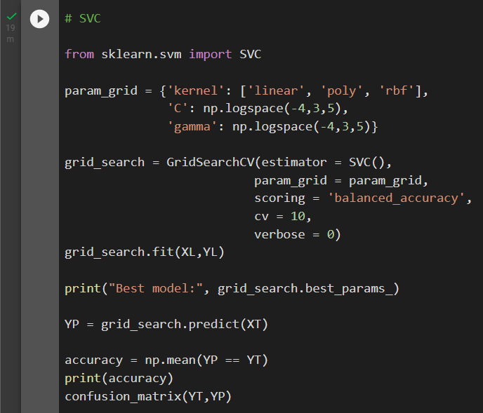
SVC
Support Vector Classification
One-versus-rest
Grid Search
Kernel : Linear, Polynomial, Rbf
C (regularizer)
Gamma

Slide 10
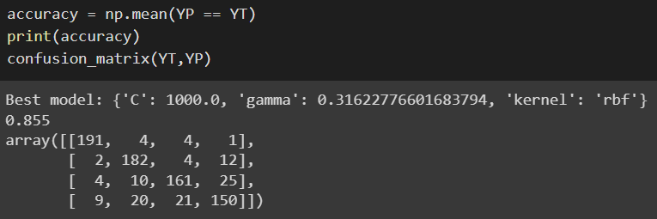
SVC results
Optimal parameters for C, gamma
Rbf kernel
Accuracy ~ 85%
Confusion matrix

Slide 11
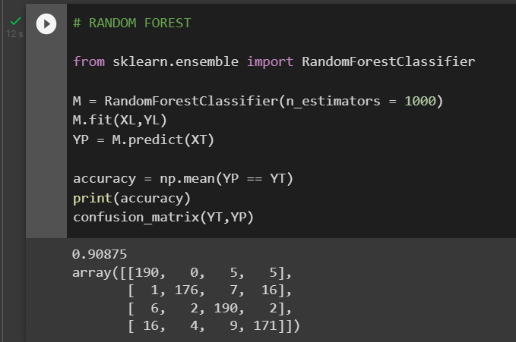
Random Forest
~ 91% accuracy
Faster than the previous two algorithms

Slide 12
Considerations
 | KRR | SVC | Random Forest
Execution Time | 19 min | 19 min | 12 sec
Accuracy | ~ 81% | ~ 85% | ~ 91%
We can observe that Random Forest has better performance than SVC and KRR both in terms of accuracy and execution time

Slide 13
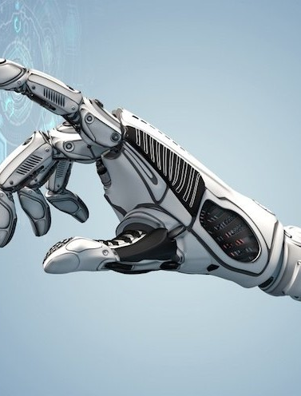
Possible applications
Prosthetics: the model can be used to control prosthetic limbs, mapping user residual muscle gestures to certain actions such as open/close hand or rotate wrist
Virtual and augmented reality
Robotics
Smart home devices

Slide 14
Thanks for your attention
Bisio Giacomo 4854973
Pastore Luca 4858713

